Slide 1
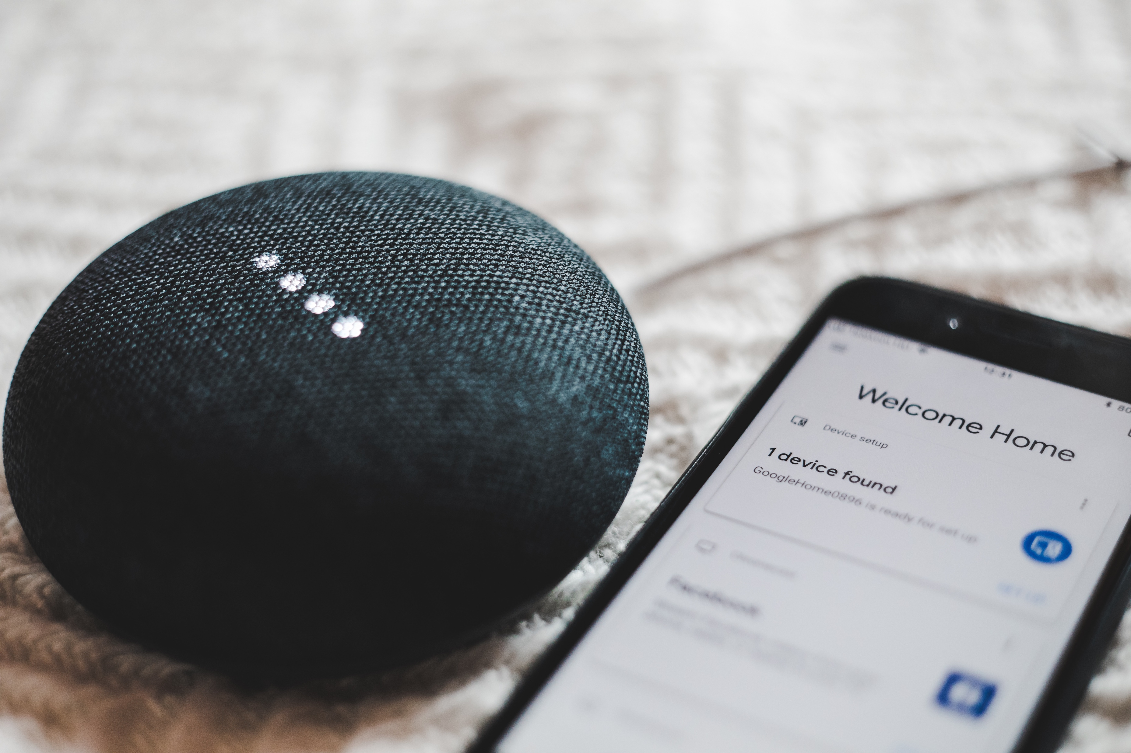
Remote IOT System
Web Design & User Experience Engr
Team WebSkr
Yukun Yuan 001446639
Mingyu Liu 001498402
Mibin Zhu 001424937
Wenzhuo Li 001447705

Slide 2
CONTENT
01
02
03
Background
Object Model
Application

Slide 3
Part One
Background

Slide 4

Background
With the development of Internet of Things technology, more and more individuals or businesses choose to collect data and process data by renting cloud devices. Therefore, the management system of these cloud devices is especially important.

Slide 5
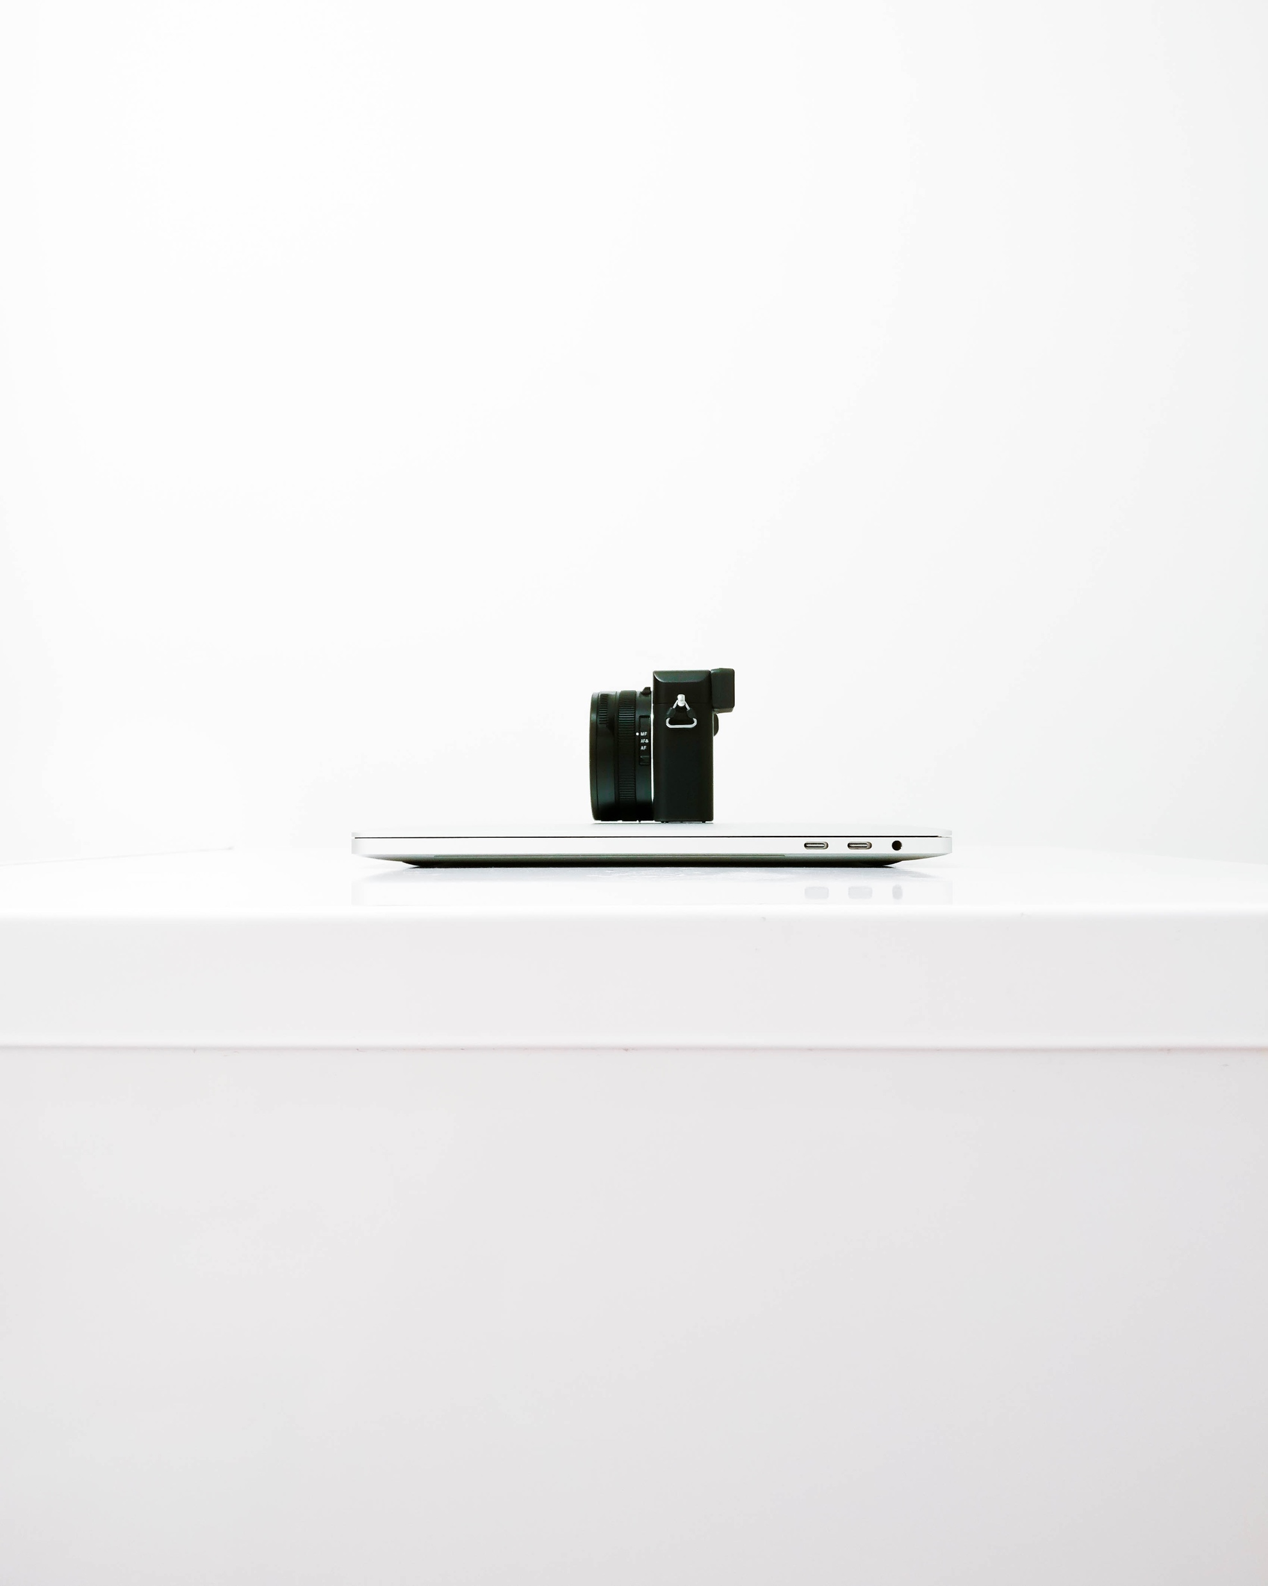
Background
01
02
03
Realtime Data
Create multiple line charts to show devices data by using MongoDB and Echarts API which already have built-in data display technology.
Map Identifier
Use Baidu Map API create a devices map based on the unique location. Users can intuitively get the geographic information of their devices.
User Friendly Interface
Implement Bootstrap to design the overall structure of the web page, simply divide the user interface and device data interface.

Slide 6
Part Two
Object Model

Slide 7
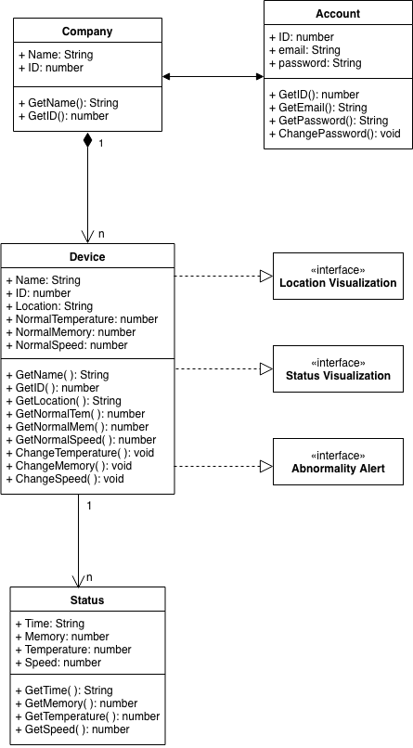
Object Model

Slide 8
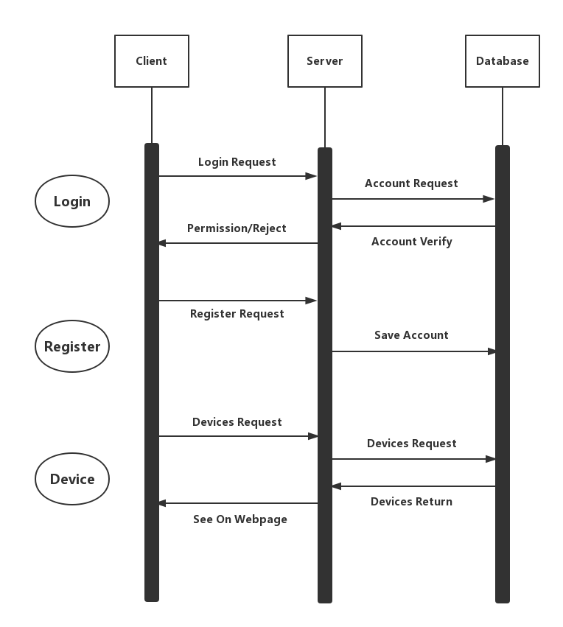
Object Model

Slide 9
Part Three
Application

Slide 10
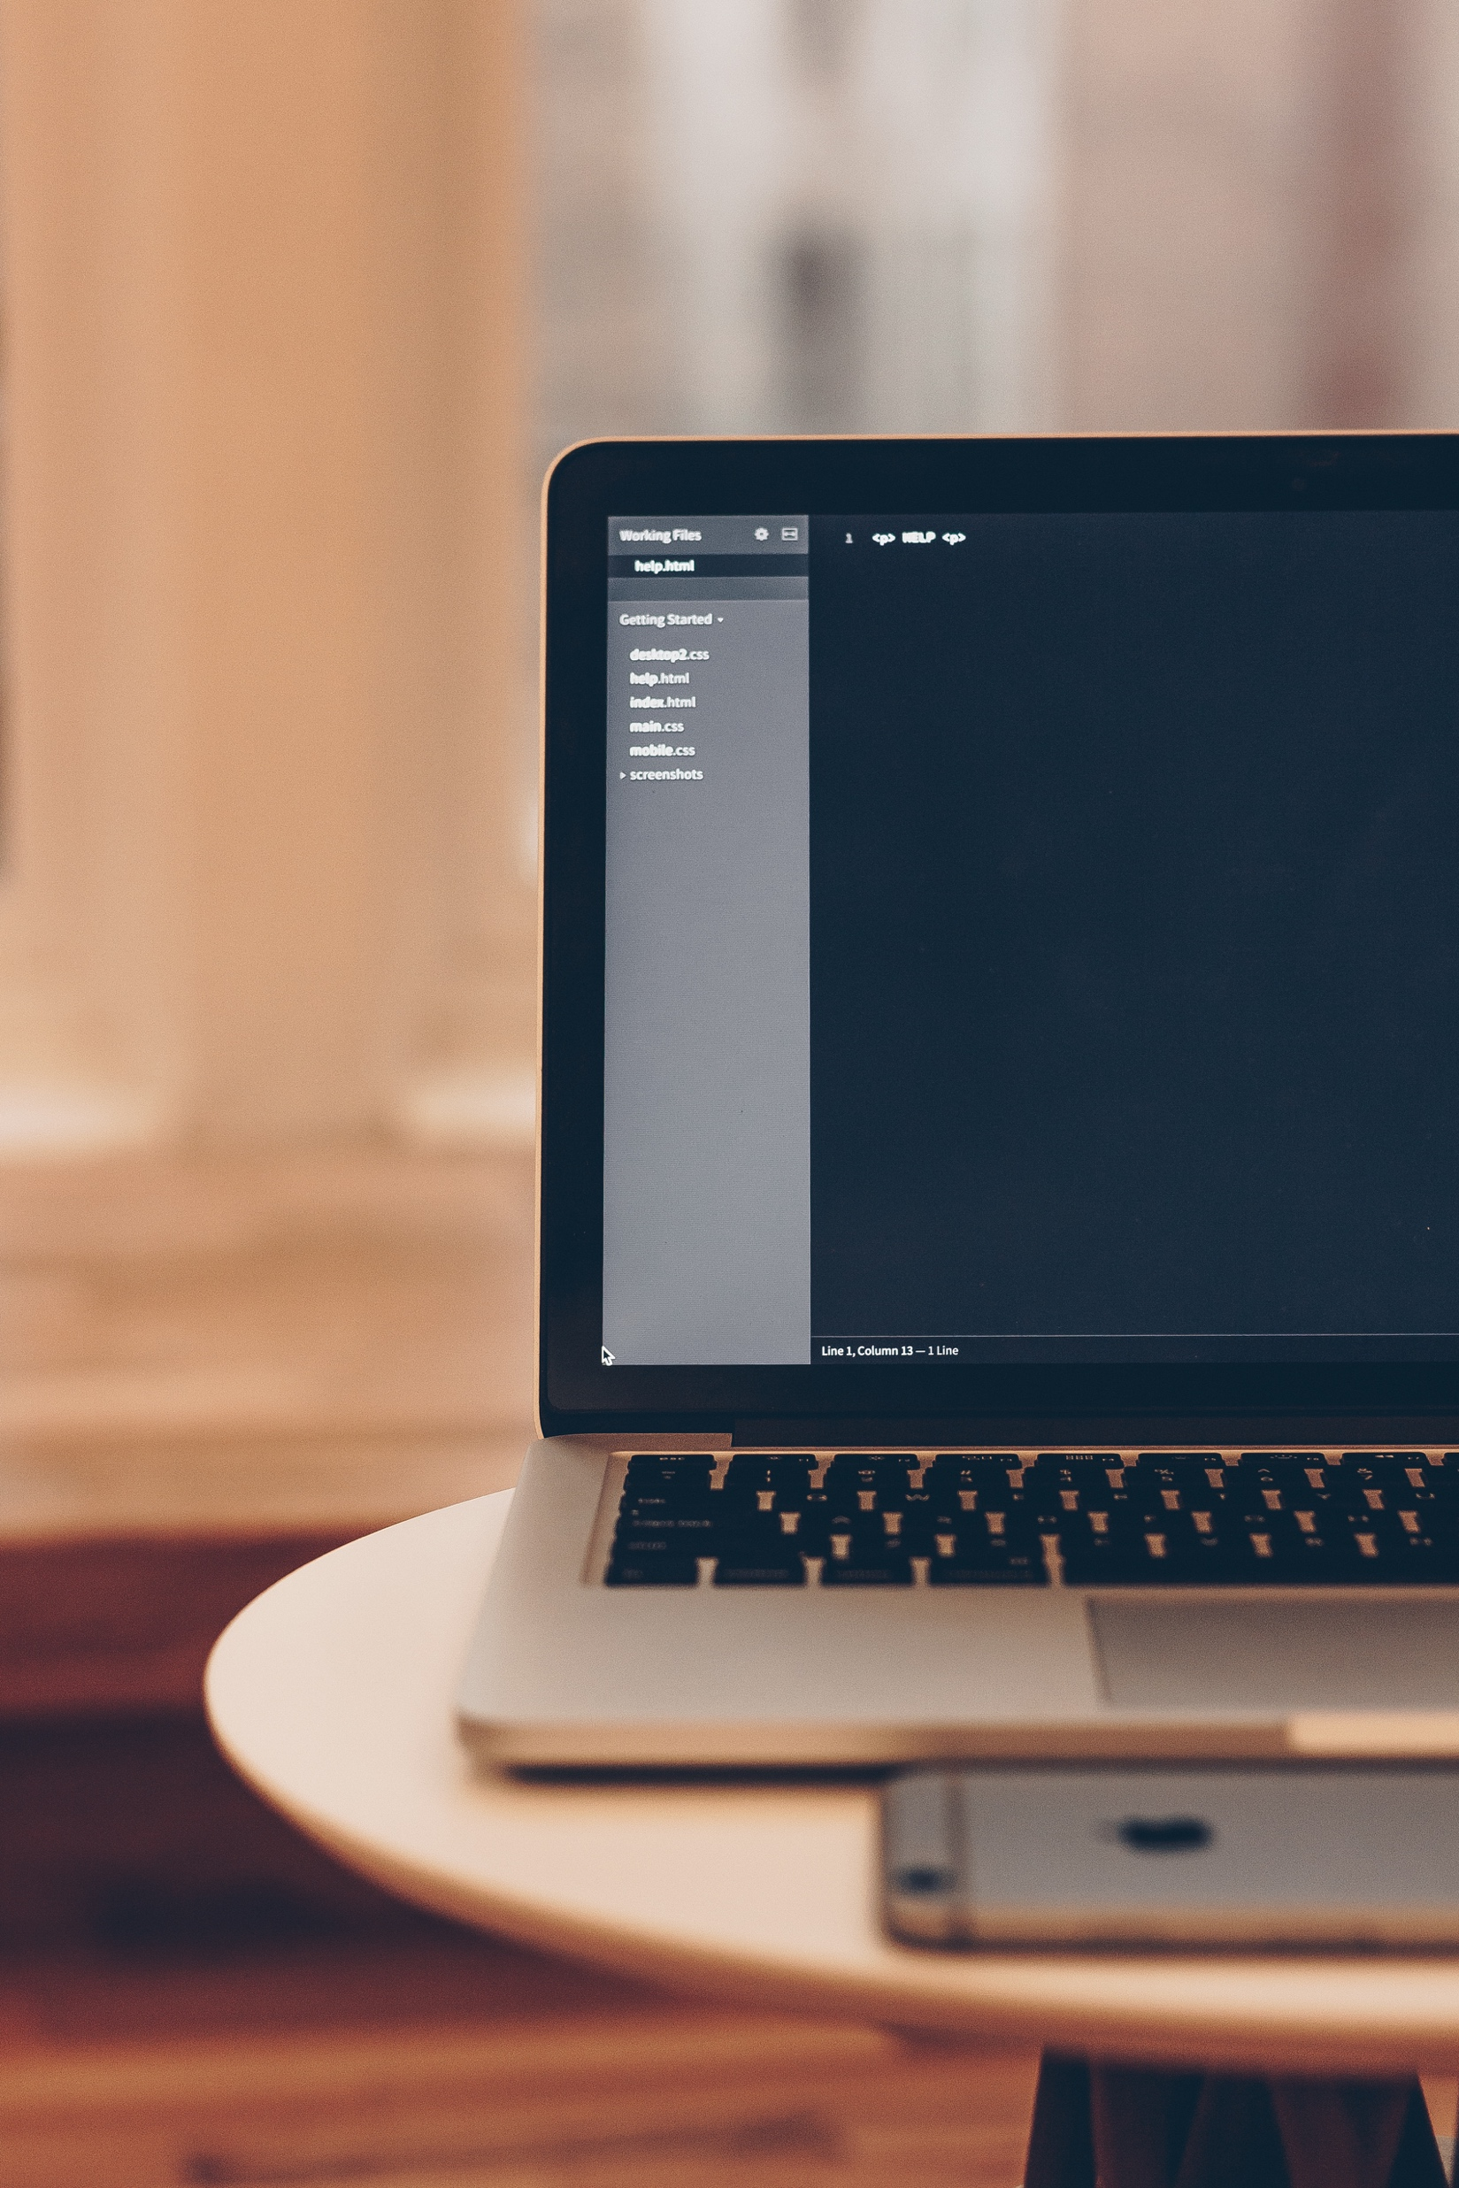
Login Panel
Login part and register part can jump to each other by clicking the button;
For login part, users need to enter their correct account username and password;
If users do not have any account, they can create a new one with username password and E-mail address;
The background picture will change with times.

Slide 11
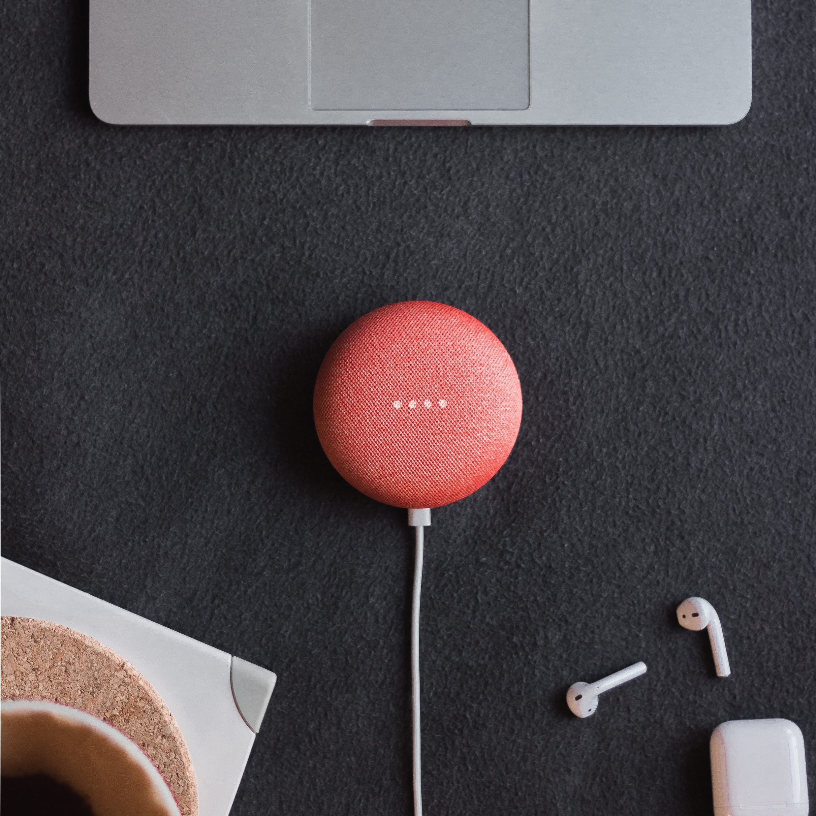
Device Panel
Find the detail information of the devices in a table by clicking Device Table;
Find the trends and real-time data of the devices in a chart by clicking Status Monitor;
Find the exact location of the devices in a map by clicking Location Visualization;
Create a new device in your account by clicking Add Devices.

Slide 12
Account Panel
Change user account with new password for login by clicking Change Password;
Users can upload their profile picture to mark their own account.

Slide 13

THANKS!

